Slide 1


Titolo presentazione sottotitolo
DAAP – HW1 Talking Instrument
Milano, XX mese 20XX
Xinmeng Luan - 10876787
Marco Bernasconi - 10669941

Slide 2
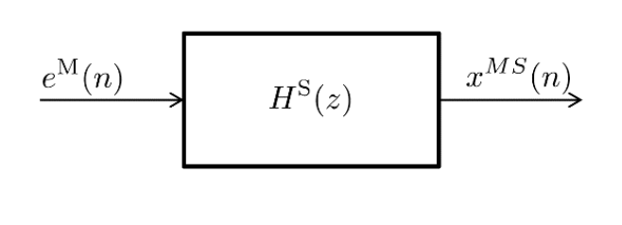
Introduction
Goal: Implementing a Talking Instrument using (Linear Predictive Coding) LPC-based cross-synthesis.
Shaping filter_Speech
Error_Music
Talking instrument
1. Wiener filtering approach
2. steepest descent method
Method
Notes:
Wiener-Hopf equations

Slide 3
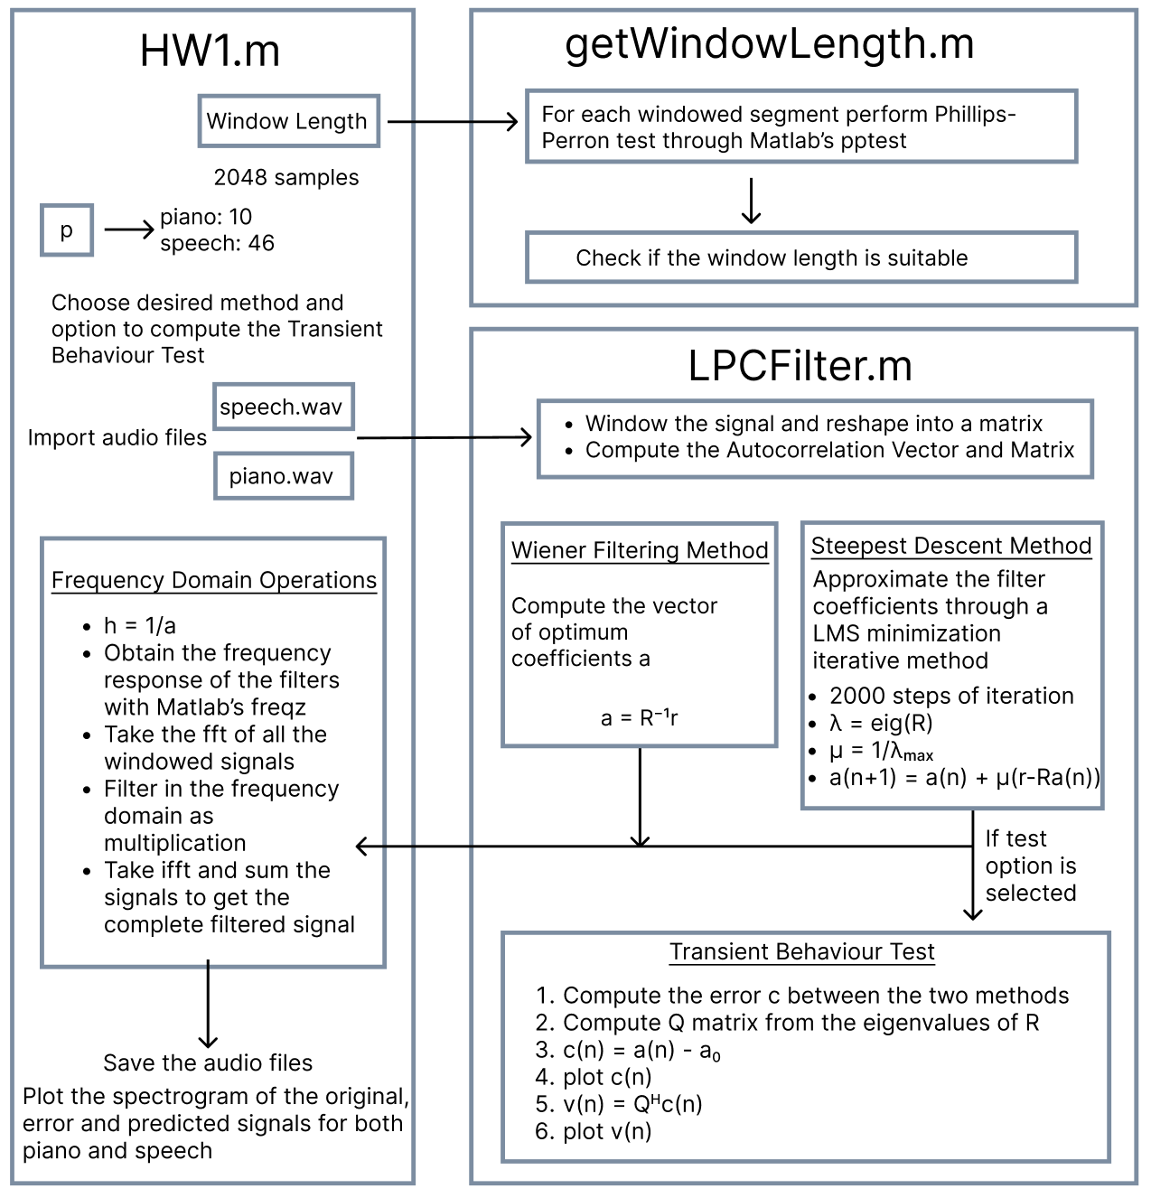
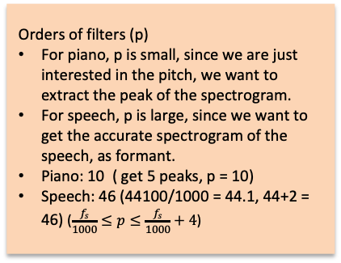
Pipeline
Orders of filters (p)
For piano, p is small, since we are just interested in the pitch, we want to extract the peak of the spectrogram.
For speech, p is large, since we want to get the accurate spectrogram of the speech, as formant.
Piano: 10 ( get 5 peaks, p = 10)
Speech: 46 (44100/1000 = 44.1, 44+2 = 46) ($\frac{f_{s}}{1000}≤p≤\frac{f_{s}}{1000}+4$)
Windowing:
Hanning window
Stationary test
COLA (hop-size: 25%)
Notes:
c(n):weight-error vector
v(n):transformed tap-weights

Slide 4
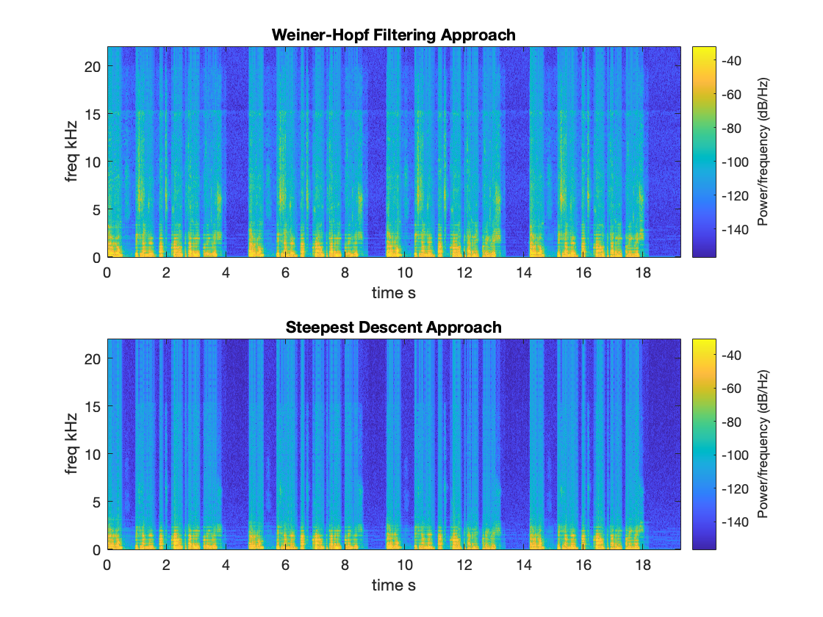
Comparison
Spectrogram comparision

Slide 5
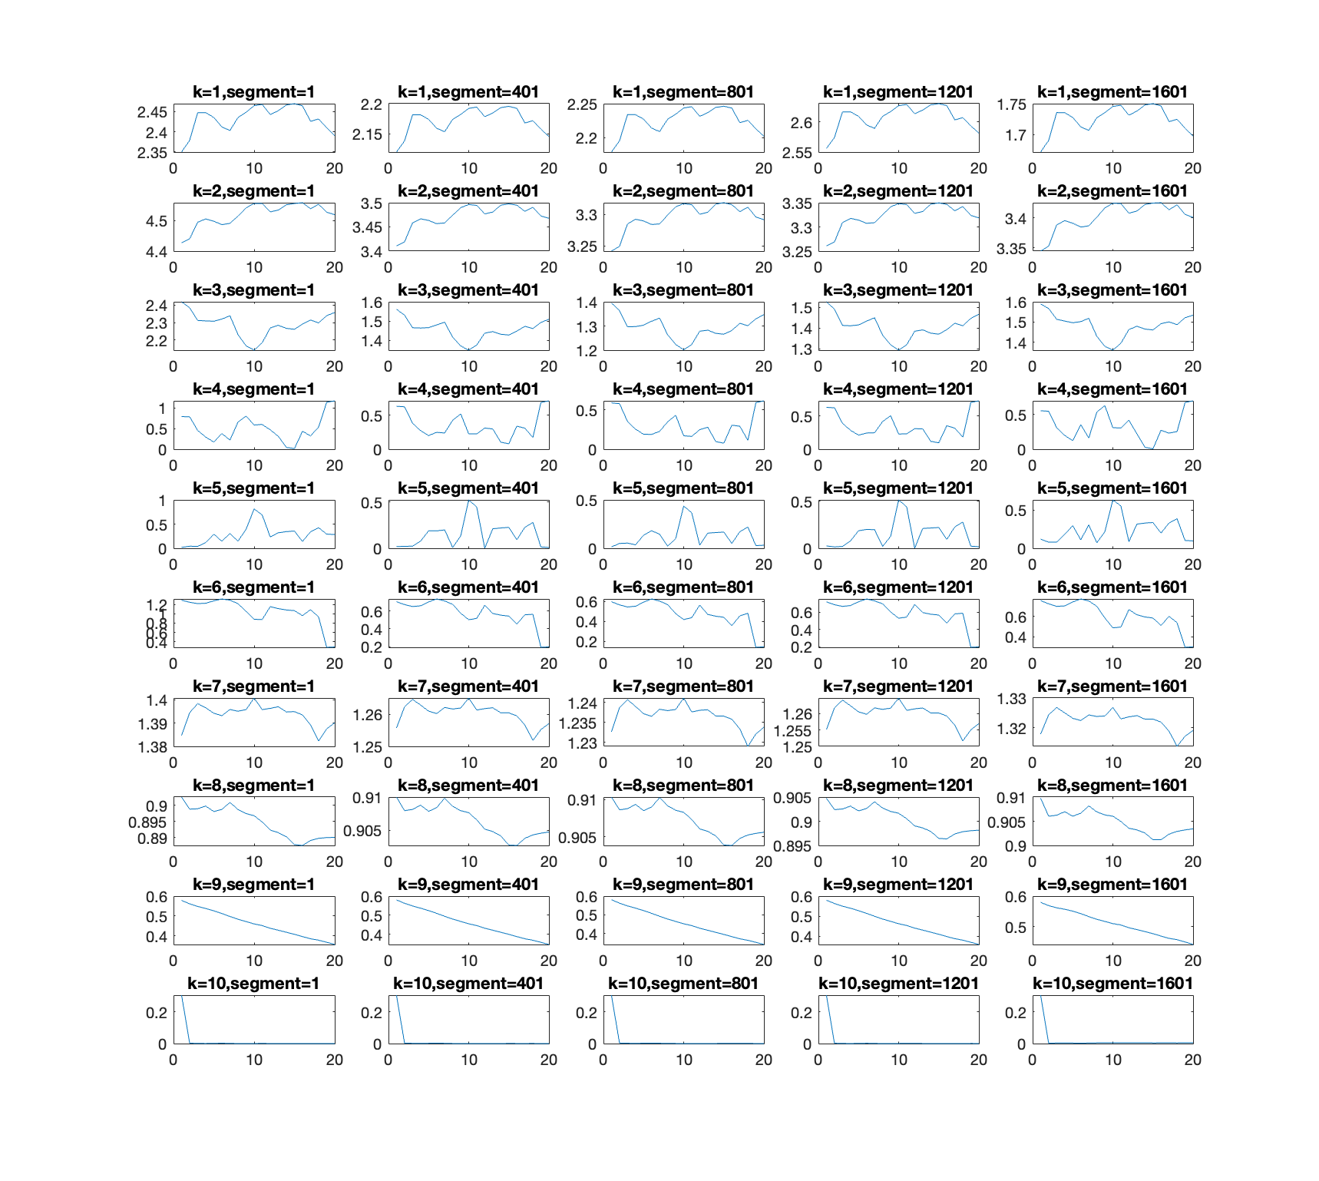
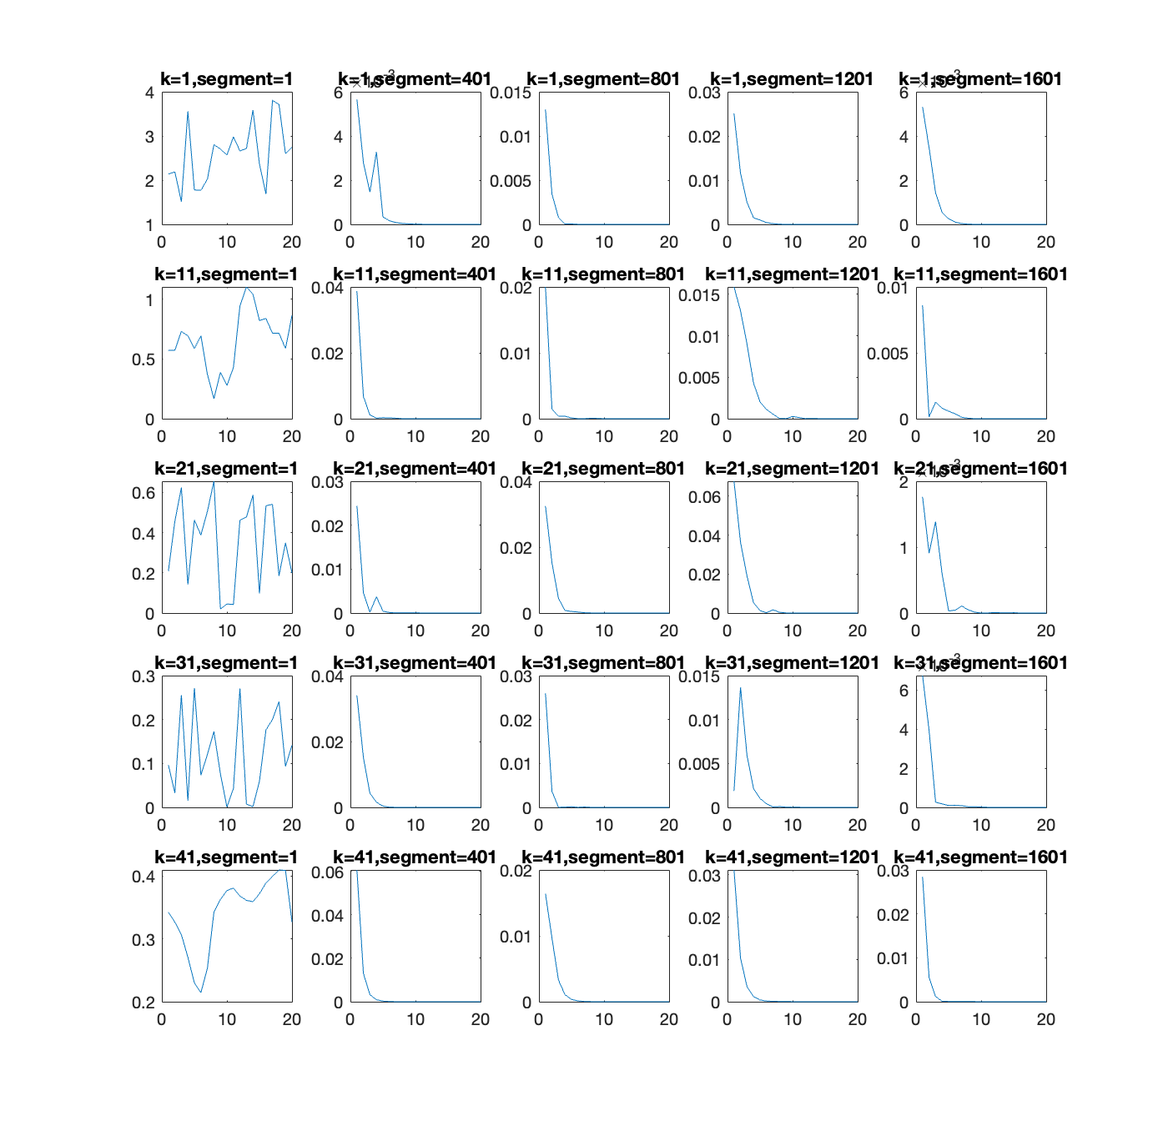
Comparison
Piano Transient Behaviour
Speech Transient Behaviour

